Slide 1
Single-Source 3D Optical Wireless Positioning
Kevin Jose ACUNA CONDORI
08/09/2026

Slide 2
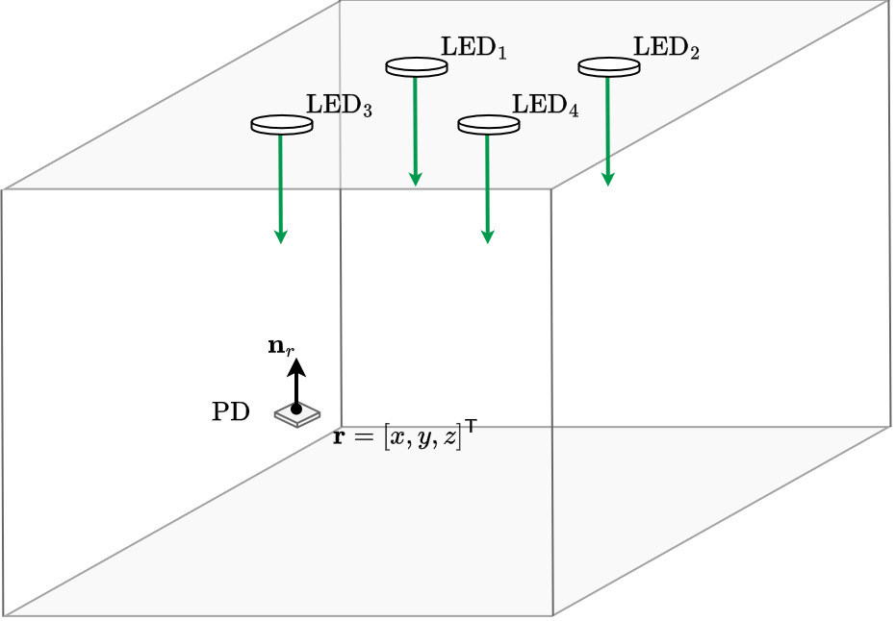

Background: Multi-LED Positioning
Optical Wireless Positioning
$$RSS=[P_{1},P_{2},P_{3},P_{4}]$$

Slide 3
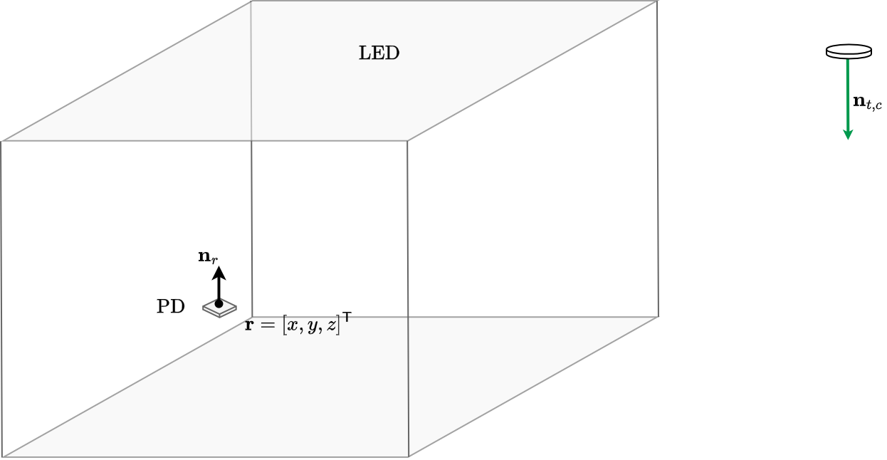
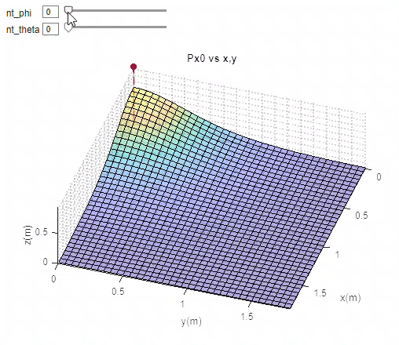
My PhD
Single Source
ISAC
Beam-steered Source
Independant of the layout

Slide 4
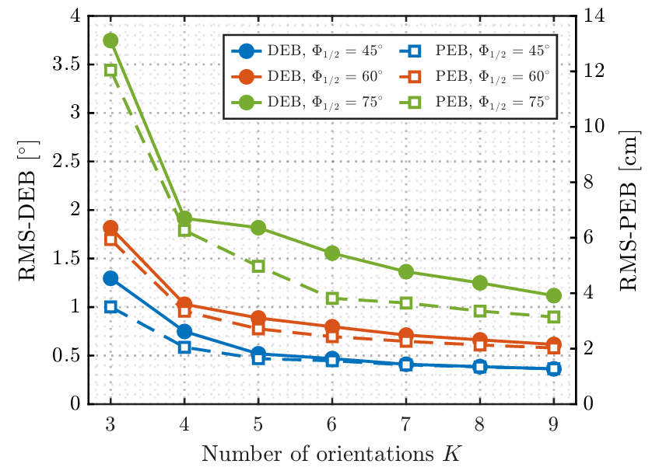
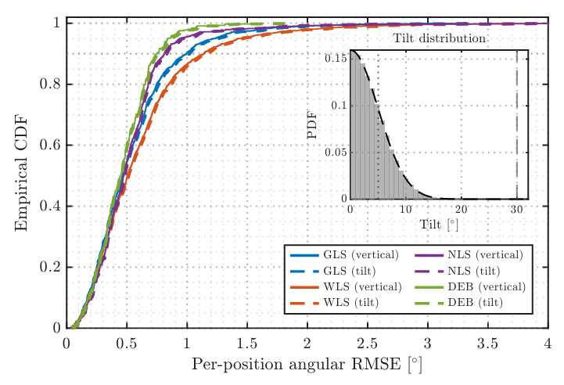
Simulations
Performance Bounds
Orientation Design
Estimation

Slide 5
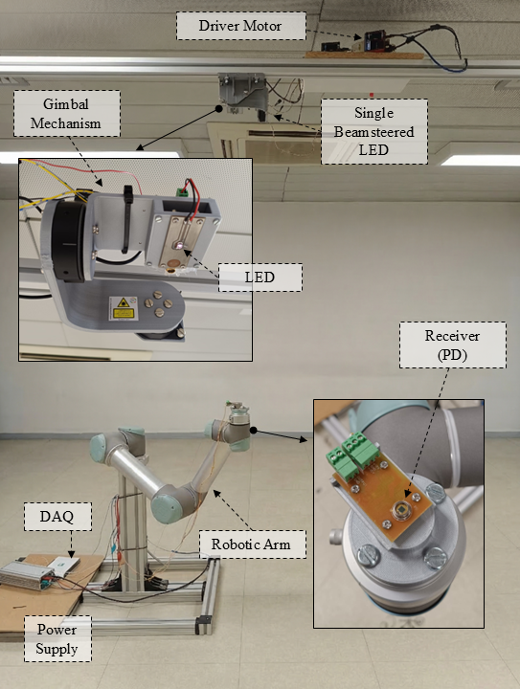
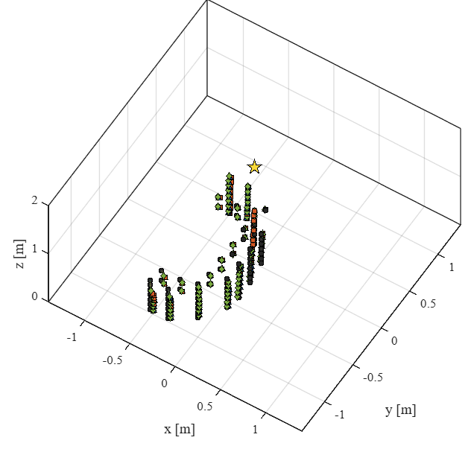
Experimental Validation

Slide 6
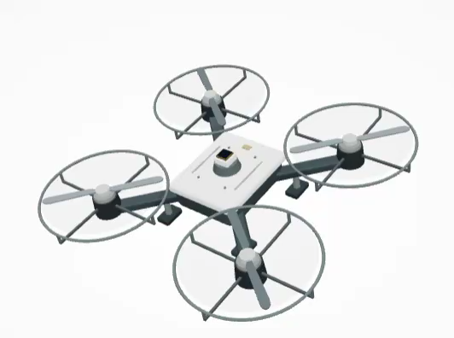
Research Direction: Receiver Orientation Diversity
How should receiver orientations be designed to maximize 3D positioning coverage?
FOV

Slide 7
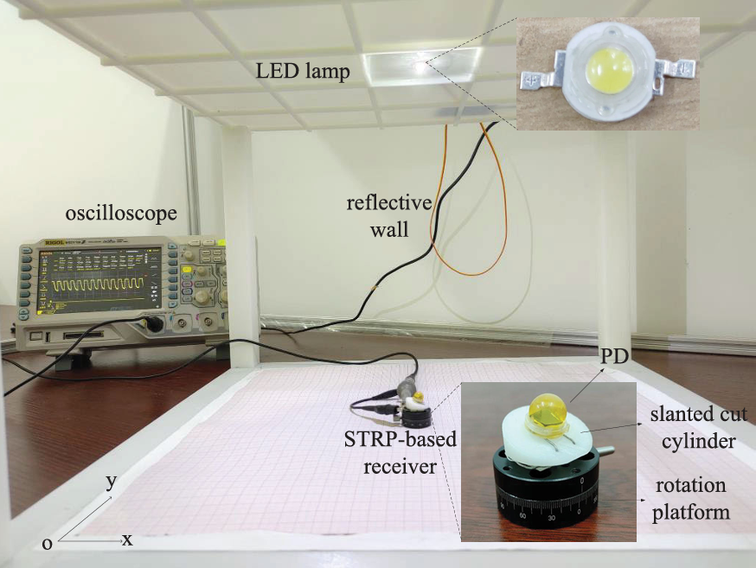
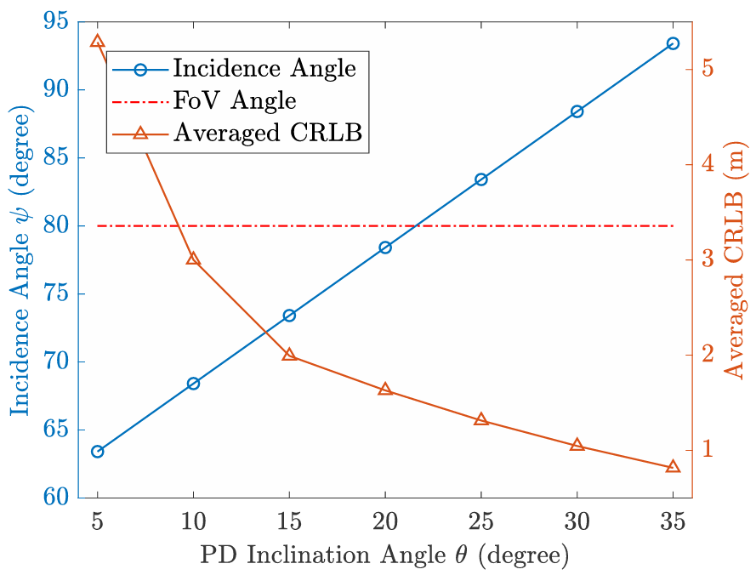
Related work: receiver diversity
Category 1: Rotatable Single-PD Receivers
Z. Wang, 2024, “Design and Performance Analysis for Indoor Visible Light Positioning With Single LED and Single-Tilted-Rotatable PD”
Summary: 2D position estimation, rotating system 1DoF, considering first-order reflections, CRLB study to choose the tilt angle and the number of samples per rotation. Regarding the 2D estimation method: LS, GWO, IGWO. Carried out in SIMULATION (CDF_90%= 11cm, testbed: 5x5x3) and EXPERIMENTALLY (APE = 0.9cm , 50 cm x 50 cm x 30 cm)

Slide 8
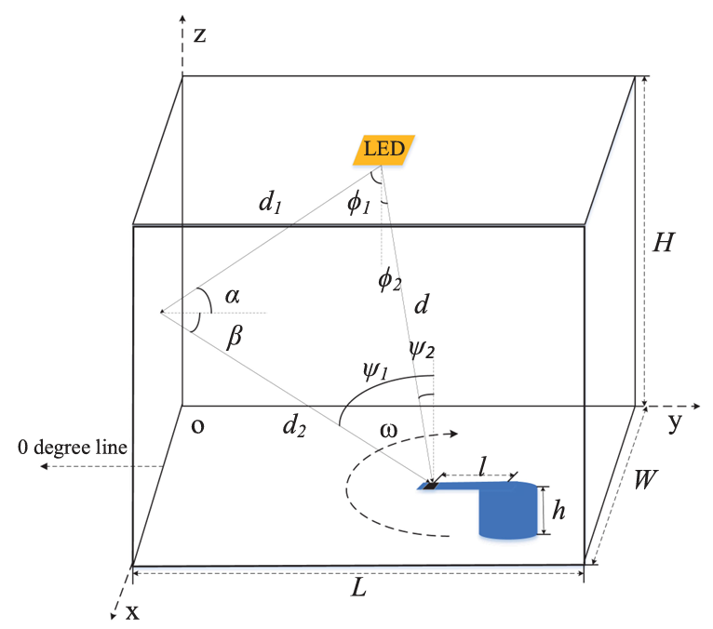
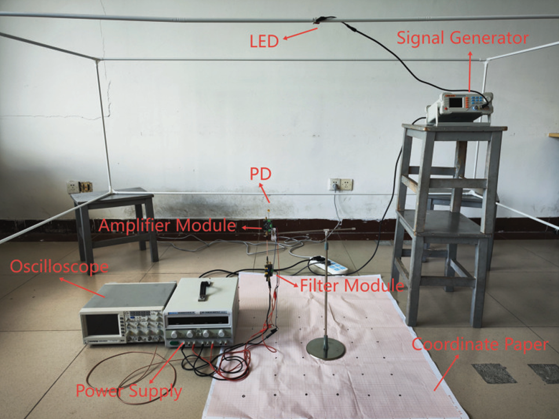
Related work: receiver diversity
Category 1: Rotatable Single-PD Receivers
Summary: 2D estimation, rotating system 1DoF, first-order reflections. CRLB. Estimation method: (1) Rotatable Positioning Model RSS + geometry (2) Machine learning (trained with simulated data: 5929 sets) Random-Forest (region classification: Interior, Wall, corner) + ELM (neural network). Results: Simulation (4m x 4m x 3.1m) with method (1) 12cm and with method (2) APE: 1.74cm. With length=10cm.
H. Shi, 2025, “Visible Light Positioning Using a Single LED and a Single Rotatable Photodetector”

Slide 9
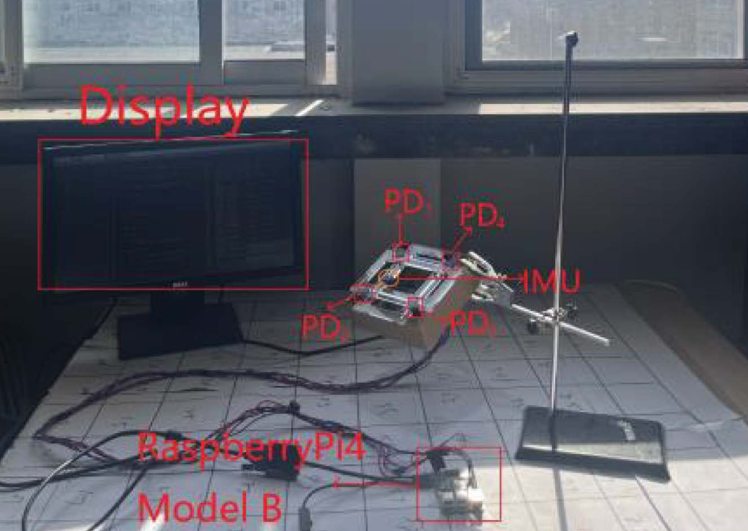
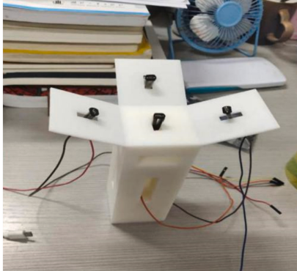
Related work: receiver diversity
Category 2: Multi-PD Receivers (“static”)
S. Ma, 2024, “Centimeter-Level 3-D Mobile Online Visible Light Positioning System With Single LED Lamp”
Qin L., 2021, “High precision indoor positioning algorithm of single LED lamp based on A-Bayes”

Slide 10
Interactive Virtual Testbed

Slide 11
Potential directions:
3D coverage optimization: Optimize receiver orientations to maximize the 3D region where a target positioning accuracy can be achieved.
Accuracy-oriented design: Jointly optimize the 3D estimator and the 2-DoF receiver orientations, and benchmark against state-of-the-art methods under identical conditions.
Receiver-side diversity study: Systematically investigate and compare different receiver-diversity mechanisms, and develop a new diversity strategy optimized specifically for positioning.

